Slide 1
Seasons Travel Mobile Application
Vivek Sharma

Slide 2

Hello!
I am Jayden Smith
I am here because I love to give presentations.
You can find me at @username

Slide 3
The Problem
1

Slide 4

The Problem
According to Good Work Labs,
Tourism related apps rank as the 7th most downloaded category of apps
85% use smartphones to plan their travel when on leisure tours
15% use download travel apps to plan a trip ahead
Most travel apps have general travel information, with no regard to seasonal information
All lifestyles change with the season in some way

Slide 5

The Proposed Solution
To create an app that will allow people to familiarize themselves with seasonal information in their own state or around the country.
Goal: To increase users’ awareness of season changing information in order to enhance their experience and help them adapt to different seasons across the U.S.
Used by travelers, residents, or those looking into moving
Similar to a travel app with filterable information by season
Users heavily involved in the design process to meet their needs

Slide 6
User Needs Analysis
2

Slide 7
User Needs Analysis: Goals
Is seasonal information important to users? If so, what type of info?
Do users’ lifestyle change with the change of season?
What features are desired on an app like this?
What types of information do similar apps and websites include, if any?
Would an increased awareness of season changing information enhance users’ enjoyment and quality of living?

Slide 8
User Needs Analysis: The Plan
Documentation Review
Season Apps
Travel Apps
Travel Websites
Semi-Structured Interviews
9 participants
Members of the community who have traveled or moved to a new location
Open and closed-ended questions

Slide 9
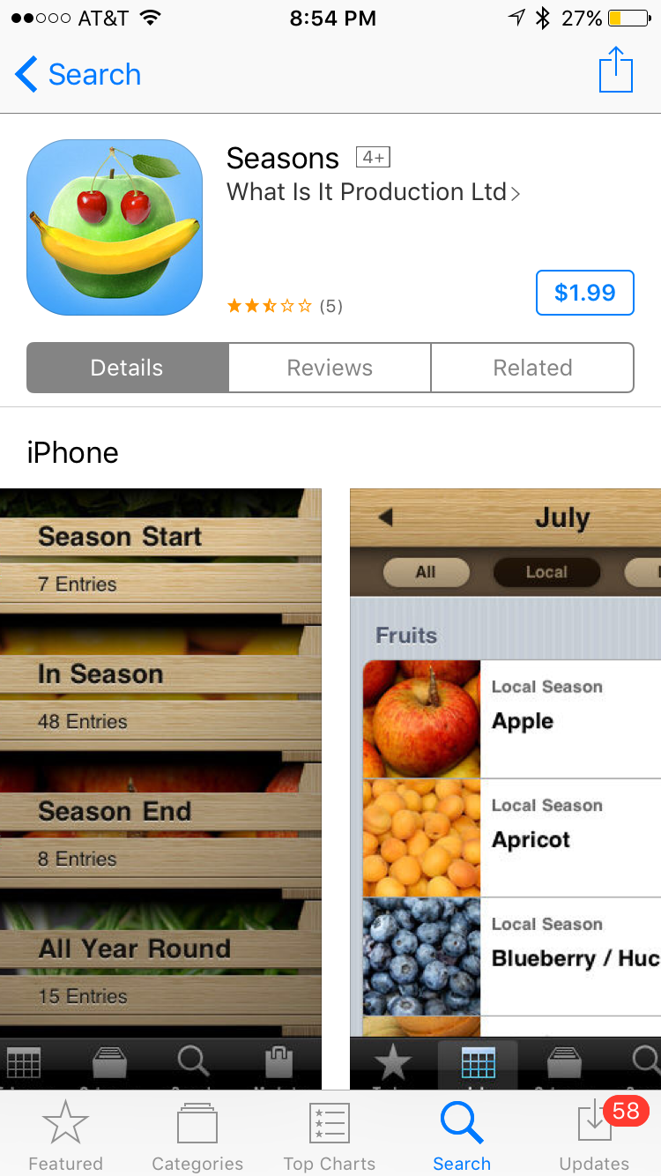
Documentation Review
Seasonal Information
Most season based app and website information was for produce
Helps users make decisions to enjoy foods at peak season
Connects to local markets

Slide 10
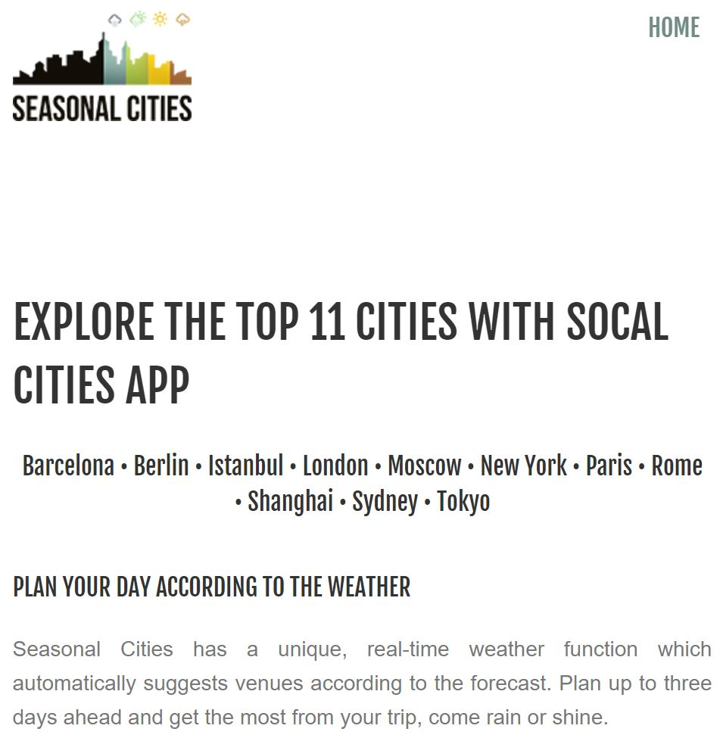
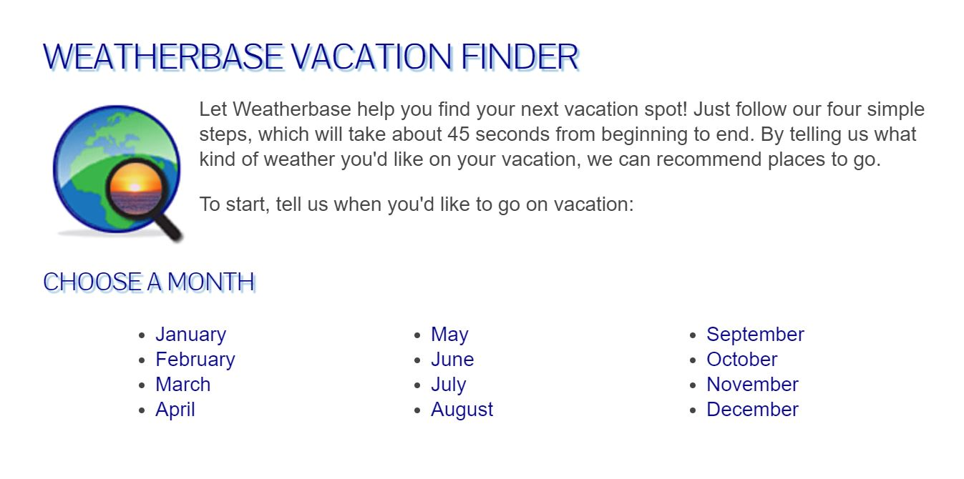
Documentation Review
Weather-Based Travel
http://seasonalcities.com/
http://www.weatherbase.com/vacation/step1.php3

Slide 11
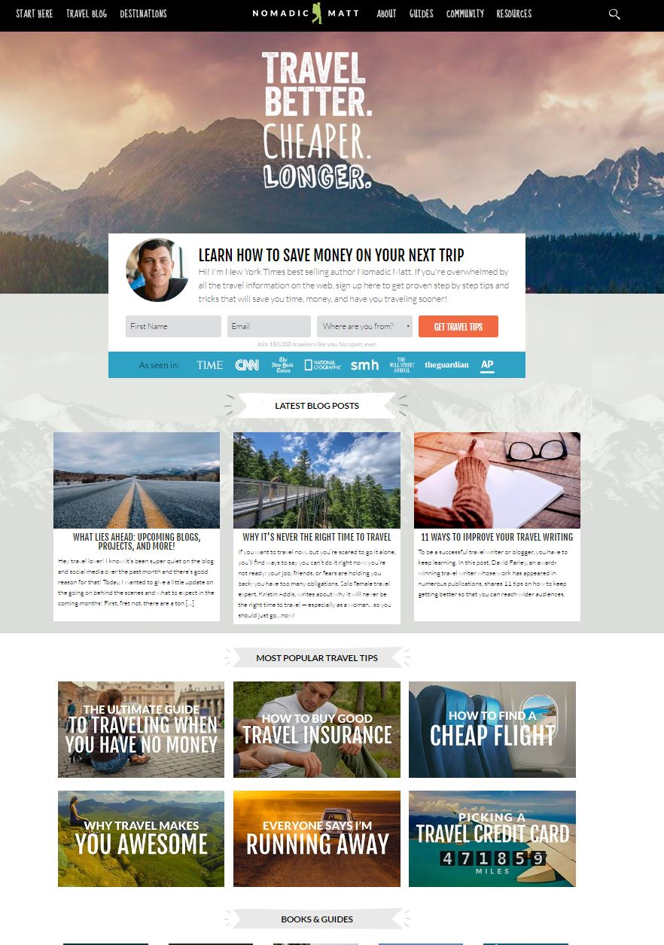
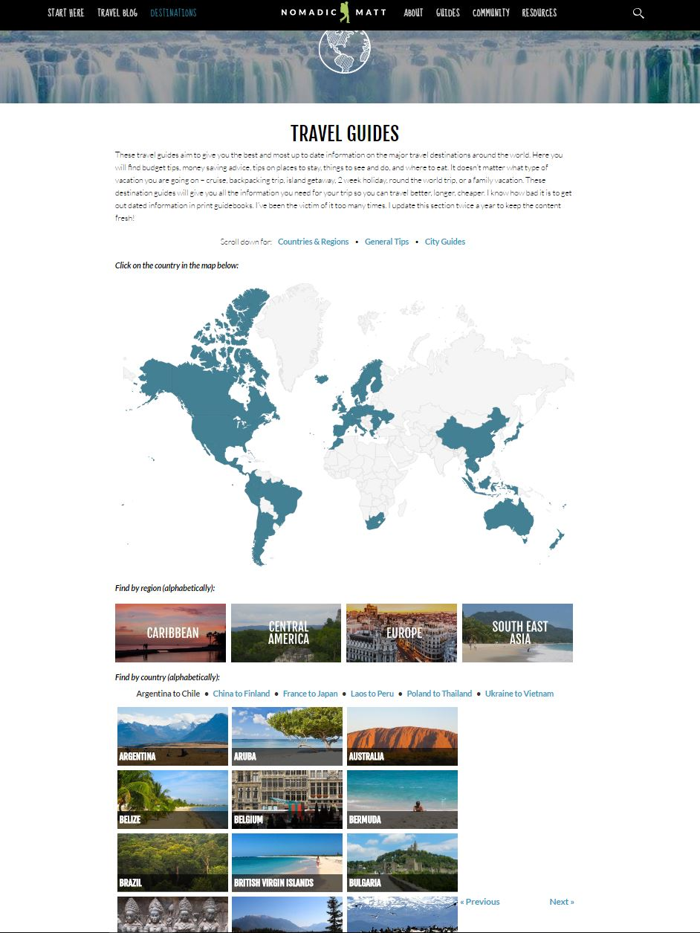
Documentation Review
Travel Sites
www.nomadicmatt.com

Slide 12
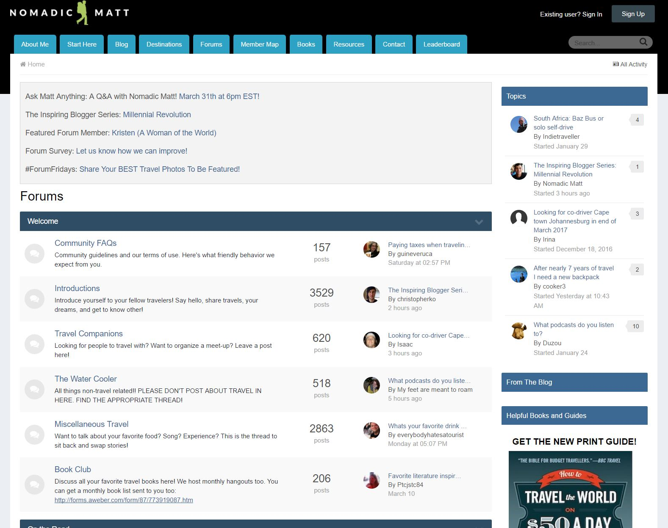
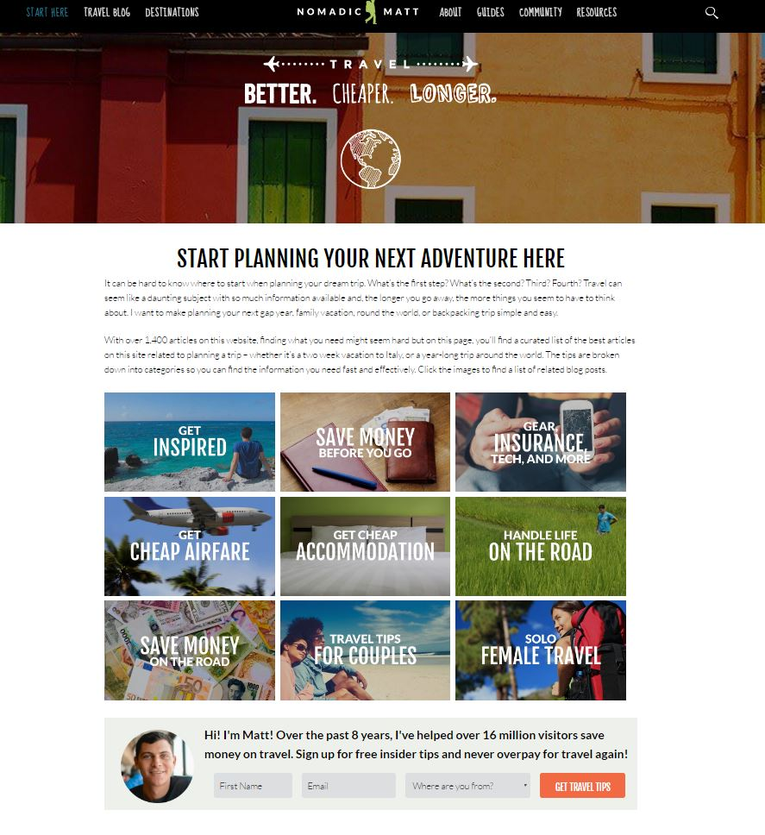
Documentation Review
Travel Sites
www.nomadicmatt.com

Slide 13
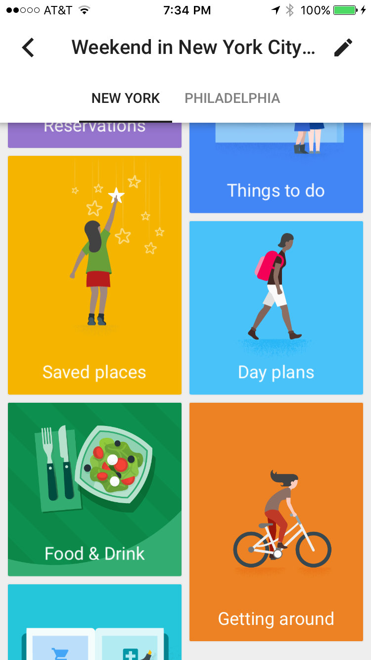
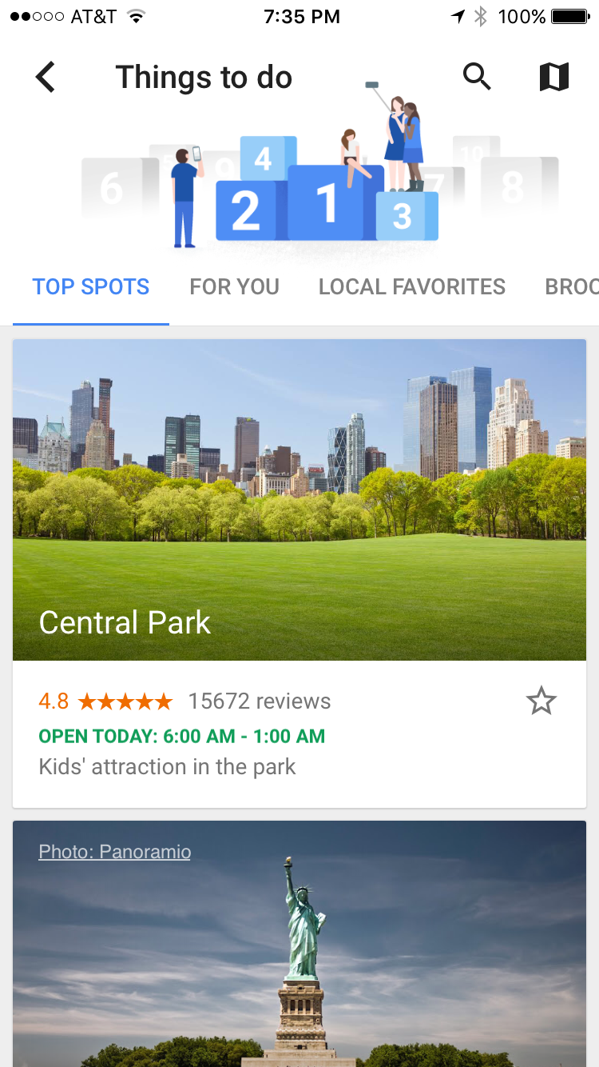
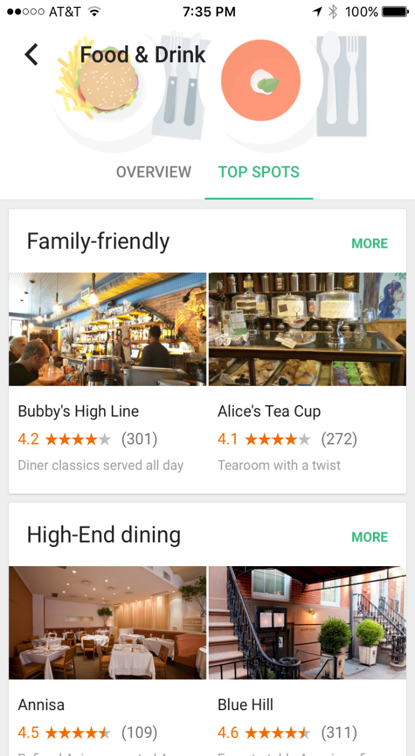
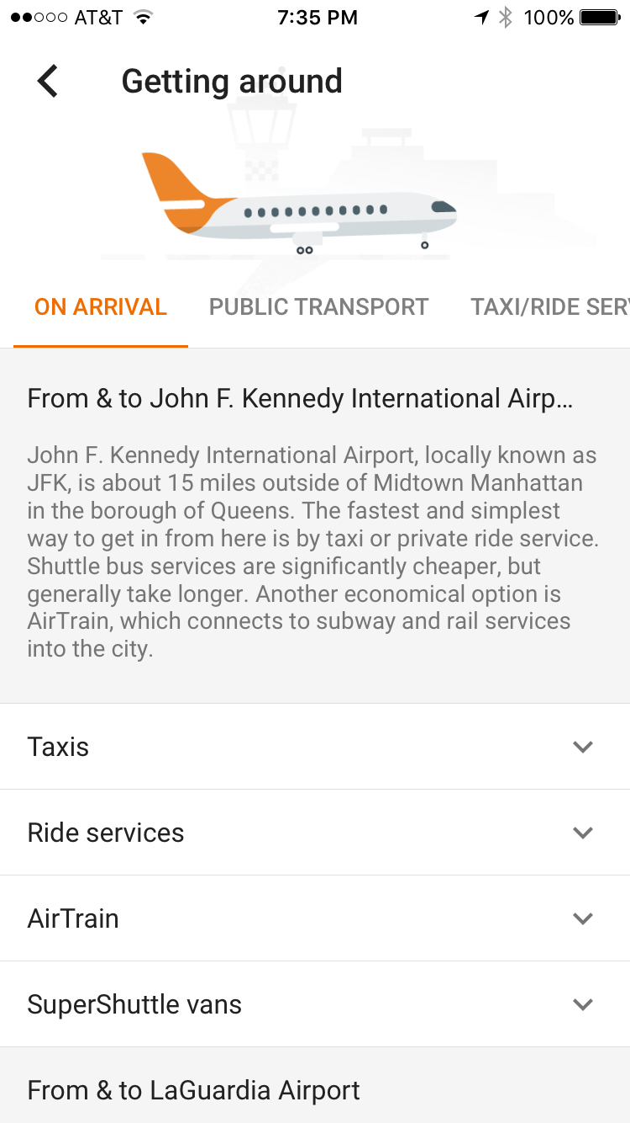
Documentation Review
Travel Apps

Slide 14
Interview Analysis
Content Suggestions
Clothing tips & packing lists
Weather forecast
Weather appropriate sports & activities
Health travel tips & health warnings
Foods in season
Attractions, things to do, events, restaurants, traffic, gyms
Seasonal Changes
Clothing
Exercise routines and travel plans
Transportation
Health, fitness, nutrition
Feature Suggestions
Share feature
Social media interaction
Mobile vs. Computer
Save feature
Free app
Notes:
Weather: most check the forecast and guess how they should dress. Many rely on people with prior experience to get informed on what they should wear.
Daily activities, indoors and outdoors, change. Some only travel during certain seasons.
Health: Many suffered from health/skin issues with the change in weather, allergies
Food: Type of meals changed with the season, and how much they eat

Slide 15
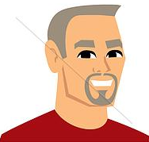

Personas: Novice User
Married to Lisa, both grew up in D.C.
They have 3 kids, all married with children and live in D.C.
Like to spend time with family, being outdoors, try new restaurants, enjoy music and art, reading, movies
Believe it’s important to enjoy life’s beauty and nature
Try to use technology minimally
Desire to move to a warmer area
Name: Joseph
User: Novice
Age: 67
Residence: Washington, D.C.
Occupation: Business Development
at Lockheed Martin (Retired)

Slide 16

Personas: Expert User
Attends college in Florida, recently graduated
Adventurous, outgoing, and loves people
Loved hiking/skiing, new cities, visiting national parks, amusement parks, and traveling while in CO
Passionate about health, fitness, nutrition
Keeps up with the latest trends
Spends weekends in FL exploring with friends
Name: Christina
User: Expert
Age: 24
Residence: Denver, CO
Occupation: Grad school student
studying Communications

Slide 17
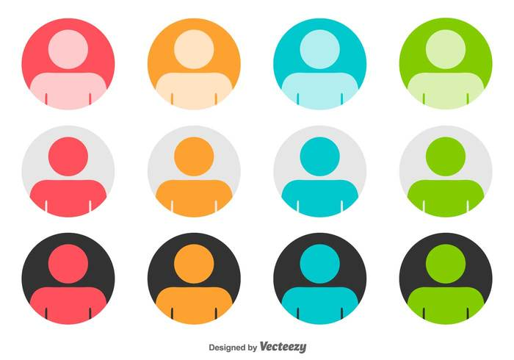
Personas → Application Design
To appeal to all users:
iPhone type navigation
Graphically driven interface
Seasons feature salient and easy to use
To appeal to expert users:
Save features, specific searches, customization

Slide 18

Requirements
The app shall have an interactive United States map on the home screen.
The app shall have six information categories…
Each state’s navigation menu shall resemble an iPhone interface…
The menu options shall be displayed using graphics/pics…
The seasonal feature shall be a slider displayed above the navigation menu…
The app shall allow users to save information…
The app shall allow users to share information to social media…

Slide 19
Conceptual Design
3

Slide 20
Conceptual Design
Cognitive
Emotional
Social

Slide 21

Cognitive
Attention
The search process is simple and convenient
Search results will include the most important and basic information needed
Perception
The ability to reorder categories according to user preferences
Memory
Design a simple menu, avoiding depth, to reduce memory load of users
Allowing users to favorite results will also reduce memory load and allow for quick retrieval
Notes:
To ensure smooth and convenient operation

Slide 22
Cognitive Cont.
Learnability and recognition
Presentation of information through icons that clearly identify their function, allowing instant recognition
Decision-Making
Incorporate user reviews and ratings
Pictures of travel destinations

Slide 23

Emotional
Bring excitement, enjoyment, curiosity, adventure, trust, and productivity
Avoid confusion, frustration, and boredom
Well organized categories
Incorporating pictures to give “travel feel”
Incorporating a save info feature and notes feature to increase productivity

Slide 24

Social
👪
Ability to share experiences, places, and info through social media, email, and text
A forums section where users can share and post
Discussion boards with wide variety of topics
Users can post questions and discussions
Allows users to interact in the travel community and gain insight
“Connect” feature allows users to join common interest groups with other people
Points system

Slide 25
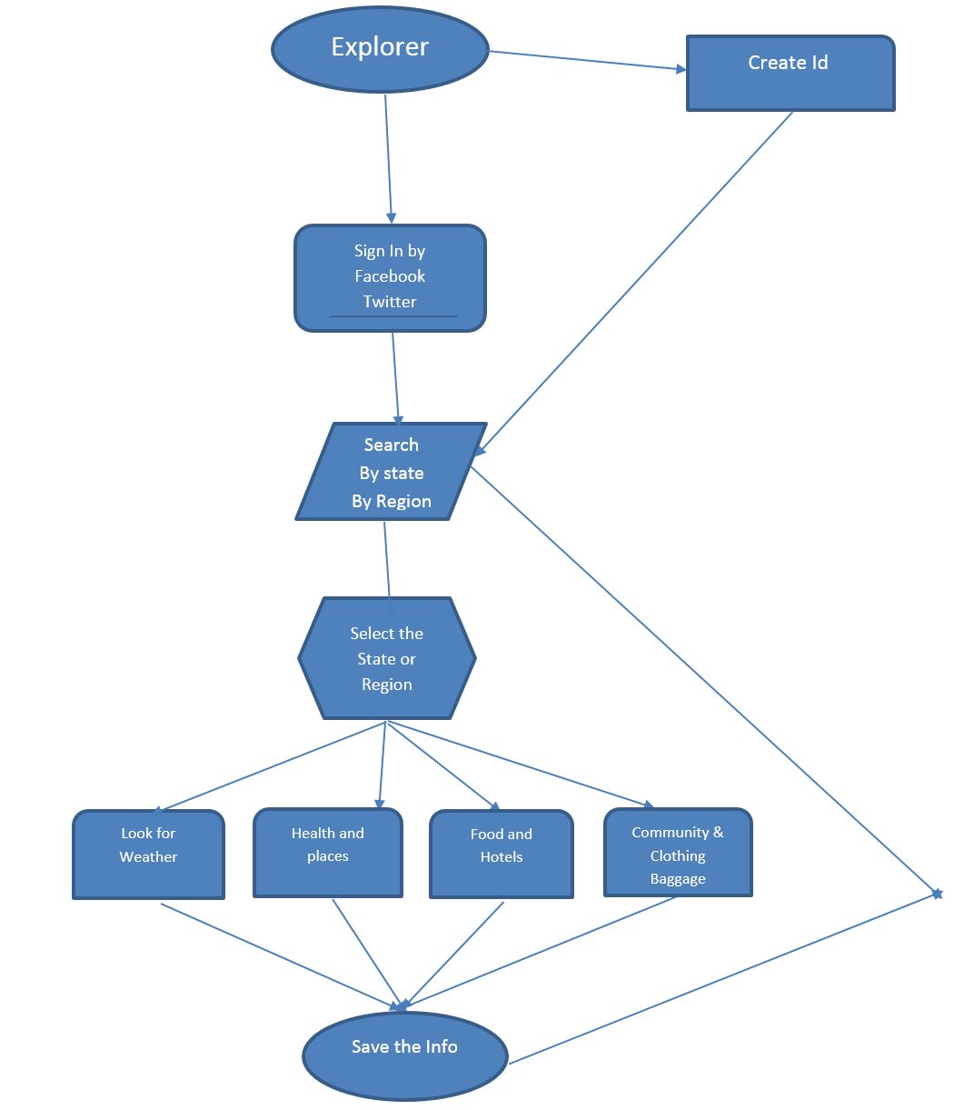
User Journey Map

Slide 26
Detailed Design
4

Slide 27
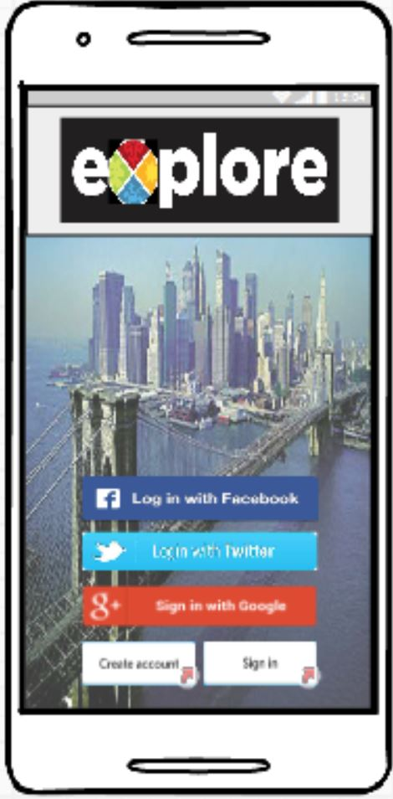
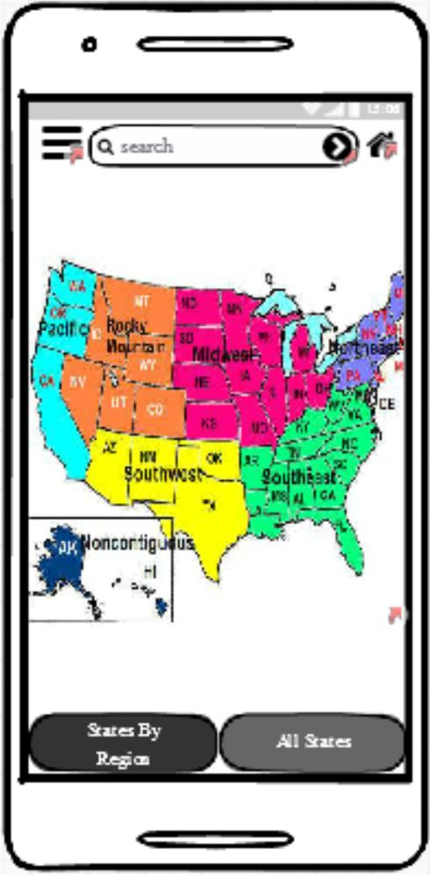
Detailed Desgn
👪
A user friendly interface.
With some login screens.
Taken to search page to select state or region.
It takes 5 to 6 steps to reach from home page to search screen.

Slide 28
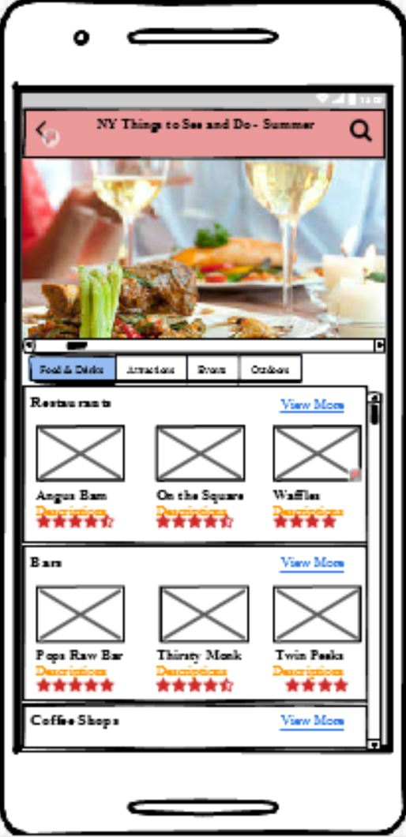
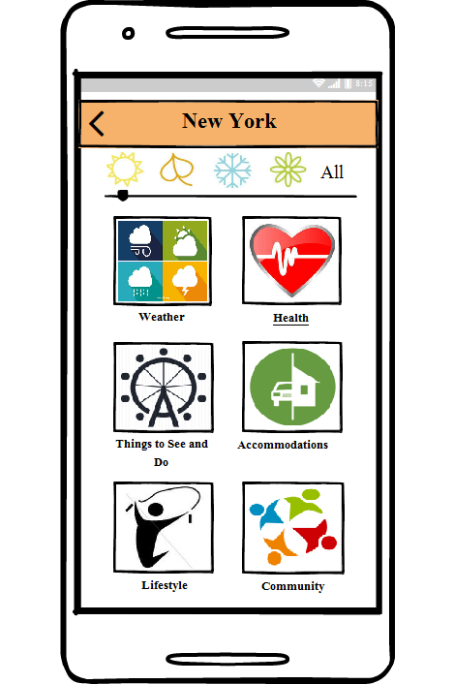
Detailed Desgn
👪
After you select the city you get to the screen to explore the options for that particular city.
Provided with icons to help user to find what they want easily.
Check the info for different seasons.
Screens to check for packing list.
Save the info and check it again.

Slide 29
Evaluation
5
Let’s start with the first set of slides

Slide 30
Evaluation Plan
Goals
Used to determine:
Clarity, effectiveness, accessibility, & learnability
User emotions while using the app
Method
Date collection: user study in a controlled setting
Students were given specific tasks to complete
After observing users, tasks and metrics were collected
Then, a walkthrough was done to gain addition insight
A survey was given to determine overall experience

Slide 31
Evaluation Plan Cont..
Data/Metrics
Time it takes to perform a task
Number of clicks to perform a task
Number of errors
User Reactions
Number of users making an error/successfully completing a task
Suggestions for the app
Positive and negative features of the app
User thoughts when performing a task

Slide 32
References
Carroll, M. (2017). Cognitive Aspects of Design [PowerPoint slides]. Retrieved from https://fit.instructure.com/courses/497338/files/37595965?module_item_id=8772587
Carroll, M. (2017). Performing Evaluations: Methods and Tools [PowerPoint slides]. Retrieved from https://fit.instructure.com/courses/497338/files/37732475?module_item_id=8784893
Google, Inc. (2017). Google Trips – Travel planner (Version 1.10) [Mobile application software]. Retrieved from http://itunes.apple.com
How mobile app benefits travel and tourism industry. (2015, June 26). Retrieved from http://www.goodworklabs.com/how-mobile-app-benefits-travel-and-tourism-industry/
What Is It Production Ltd. (2011). Seasons (Version 3.2) [Mobile application software]. Retrieved from http://itunes.apple.com

Slide 33
Thanks!
Any questions ?

